Slide 1

HELLO!
I am Chetanya Ved
FORMER E-CELL HEAD OF BVPIEEE
IMA FINALISTS
linkedin.com/in/chetanya-ved-23b8362a/

Slide 2
“The Only Way To Win Is To Learn Faster Than Anyone Else.”

Slide 3
It’s Not About Ideas It’s About Making Ideas Happen
-SCOTT BELSKY

Slide 4
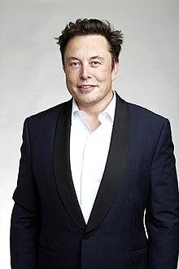


Slide 5

ENTREPRENEURSHIP
What is it?

Slide 6

Entrepreneurship
Entrepreneurship is both the study of how new businesses are created as well as the actual process of starting a new business.

Slide 7

PREREQUISITES FOR GETTING INTO IT?(SKILLS)
Clarity of An Idea
Complete Research
Team For Execution
Execution Monitoring System
Long Term Business Planning
Flexible with Strategies

Slide 8

STARTUPS
What is it?

Slide 9
STARTUPS
Big Move Depicted by Small Word
Requires Great Power And Mind For Execution

Slide 10

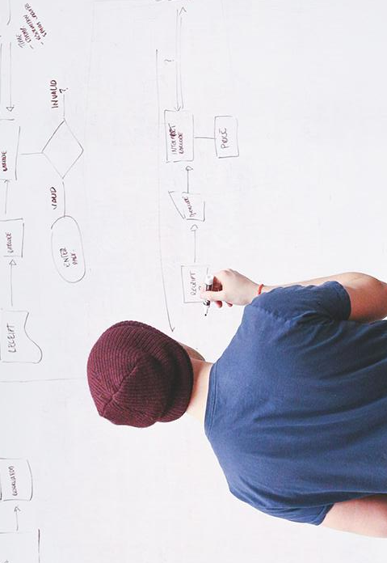
THANKS!
Any questions?
You can find me at:
www.linkedin.com/in/chetanya-ved-23b8362a/

Slide 11
LEAN METHODOLOGIES

Slide 12
Motive of Lean Startup
Lean stands for
->creating more value for customer with fewer resources

Slide 13
3 STEPS OF LEAN STARTUP
Find
Execute
Validate
Business Idea

Slide 14
5 Lean Principles
Value, Stream ,Flow,Pull And Perfection

Slide 15
Lean Business Model
Who adopted this Lean Business Strategy?
What they Achieved?
Notes:
Later on

Slide 16
IDEATION
“If you want something new, you have to stop doing something old.” – Peter F. Drucker

Slide 17
What? Why? How? When?
Important Things To Figure Out while developing an Idea
Notes:
What is start up
Why we should go for it?
How we should go for it?
When we should go for it?

Slide 18
IDEA!!
An Important Phase!!

Slide 19
QUESTIONAIRE
WHAT?
WHY?
HOW?
WHEN?
YOUR IDEA IS?
ARE YOU INTERESTED IN THIS?
WILL YOU EXECUTE IT?
WILL BE REQUIRED?(PRODUCT)

Slide 20
IDEA CATEGORISATION PROCESS
IDEA
TECHNICAL
NON-TECHNICAL
PRODUCT BASED
SERVICE BASED
PRODUCT BASED
SERVICE BASED
Notes:
Technical ->product based->microsoft ,apple
technical->Service based->godaddy.com,walmart
Non- technical-> product based->p&g,jubliant
Service based->SWIGGY

Slide 21
Time for Analysis
0.Identification of problem statement
1.Feasibility of an Idea
2.Resource Requirement
3.Plan for Execution
4. SWOT (BEFORE EXECUTION)
5.Market Identification
6.Time Investment
Helps to keep you on track
What problem are you solving?
Correct identification of resources which are required
Strategic planning for execution of idea
Identification and Rectification of strength and weakness
Where it is required
How much time will you ready to give?
(self estimation of time)

Slide 22
IDEA DEVELOPMENT PROCESS BY STARTUPS
Brainstorming
Support trends
Market trends
Demographic trends
Employees
Competition,suppliers
Focus Groups
Formal R&D

Slide 23
TIME FOR SOME IDEA DEVELOPMENT

Slide 24
IDEA
LEARN
BUILD
B-M-L LOOP
DATA
PRODUCT
MEASURE

Slide 25
Research Build Plan
Journey from Idea to Startup

Slide 26
THREE TRACKS OF WORKSHOP
RESEARCH
BUILD
PLAN

Slide 27
RESEARCH
1

Slide 28
RESEARCH
PRODUCT RESEARCH
MARKET RESEARCH

Slide 29
PRODUCT RESEARCH
Phase of Product Development!!

Slide 30
PRODUCT RESEARCH
(Key points to be kept in Mind)
Need to know purpose
Question to its existence
Customer targeting segment
Question its technical feasibility
Potential market size
What effect will it have on the market for your existing products
Who are your competitors

Slide 31
"The aim of marketing is to know and understand the customer so well, the product or service sells itself."
- Peter Drucker

Slide 32
MARKET RESEARCH
Phase of capturing the market!!

Slide 33
TOPICS TO BE COVERED
What is Market Research?
Need For Market Research?
Techniques for Market Research?

Slide 34
WHAT IS MARKET RESEARCH?
Market research provides important information which helps to identify and analyze the needs of the market, the market size and the competition.

Slide 35
Why is it Required?
Market research provides detailed insights into the competitors, understand customers' pain points & preferences, latest market trends, consumer buying patterns, economic shifts, and demographics.

Slide 36
What are the Techniques Of Market Research?
Or
How it can be done by startups initially?

Slide 37
MARKET RESEARCH
PRIMARY
SECONDARY
Qualitative
Quantitative

Slide 38
Primary Market Research Techniques
Quantitative
Qualitative
Surveys
Questionnaire
Phone/one-to-one conversion
Focus Groups
In-Depth Interviews
Observation

Slide 39
SECONDARY RESEARCH
Public Sources
Commercial Sources
Educational Institutions

Slide 40
BUILDING PROCESS
Time To Do Some Practical Work!!

Slide 41
Product Development Process
1
2
3
4
5
Concept Development
System Level Design
Detail design
Testing & Refinement
Production Ramp-Up
IDEATION
SOLUTION DEVELOPMENT AS WELL AS WORKING OF SOLUTION
PRODUCT DESIGNING AS WELL AS BUILDING.
PRODUCT ASSESSMENT
`PRODUCTION OF PRODUCT

Slide 42
PRODUCT INNOVATION CONCEPT
The Development and market introduction of a new, redesigned or substantially improved good or service.
Examples of product innovation by a business might include a new product's invention;
Technical specification and quality improvements made to a product; or the inclusion of new components, materials or desirable functions into an existing product.
Read more: http://www.businessdictionary.com/definition/product-innovation.html

Slide 43
S-P-S
Strategy
Planning
Simulation

Slide 44
Keep It Variable (Always)
STRATEGY
SHORT TERM
LONG TERM

Slide 45
Planning And Team formation
WHERE PLANNING IS REQUIRED?
Team Formation
Product Development
Marketing Strategy
Notes:
Planning requires team
Team building plays very important role it.
Everyone’s opinion regarding the project is important
Why is it important->works goes on smoothly
Team building requires ->correct identification of strength->choose ethical people->identify their choices and interest
->At initial phase try to get the psychology of each and every member of the team so that later stage problems will not occur
After that start developing the plan for the project.at initial stage consider it as a project->due to this you will start learning and learning turn out to be interesting.
Make timeline of your project -> and give time limit to each and every member of the team

Slide 46

SIMULATION

Slide 47
CONCEPT TESTING APPROACH

Slide 48
Where To Test Features
Which groups should be focus when company has to start testing concept:-
Focus groups
Surveys
Test marketplace

Slide 49
TWO SCALES USED FOR TESTING FEATURES
MAXDIFF SCALING
TESTING FEATURES
CHOICE MODELLING

Slide 50
TESTING PREFERENCES
No. Of Standard approaches to testing preference b/w product concept and their potential competitors
MONADIC TESTING -RATE A SINGLE PRODUCT CONCEPT-EVALUATING A CUSTOMER ATTENTION TOWARDS SINGLE PRODUCT RESPONSE
SEQUENTIAL MONADIC TESTING-RATE A MULTIPLE PRODUCTS CONCEPT AT A TIME
PAIRED COMPARISON TESTING-POTENTIAL CUSTOMER COMPARE TWO PRODUCTS CONCEPT AT THE SAME TIME TO ALTER WHICH IS BETTER

Slide 51
Business Planning
Here comes the financial strategy for your product!!

Slide 52
B-Plan
Is it important to have the plan in written or just have in mind doesn’t works?
How can we measure the success rate of our start up?
From where should i start from?

Slide 53
Lean Business Model
TIME FOR THE HANDS-ON EXPERIENCE

Slide 54
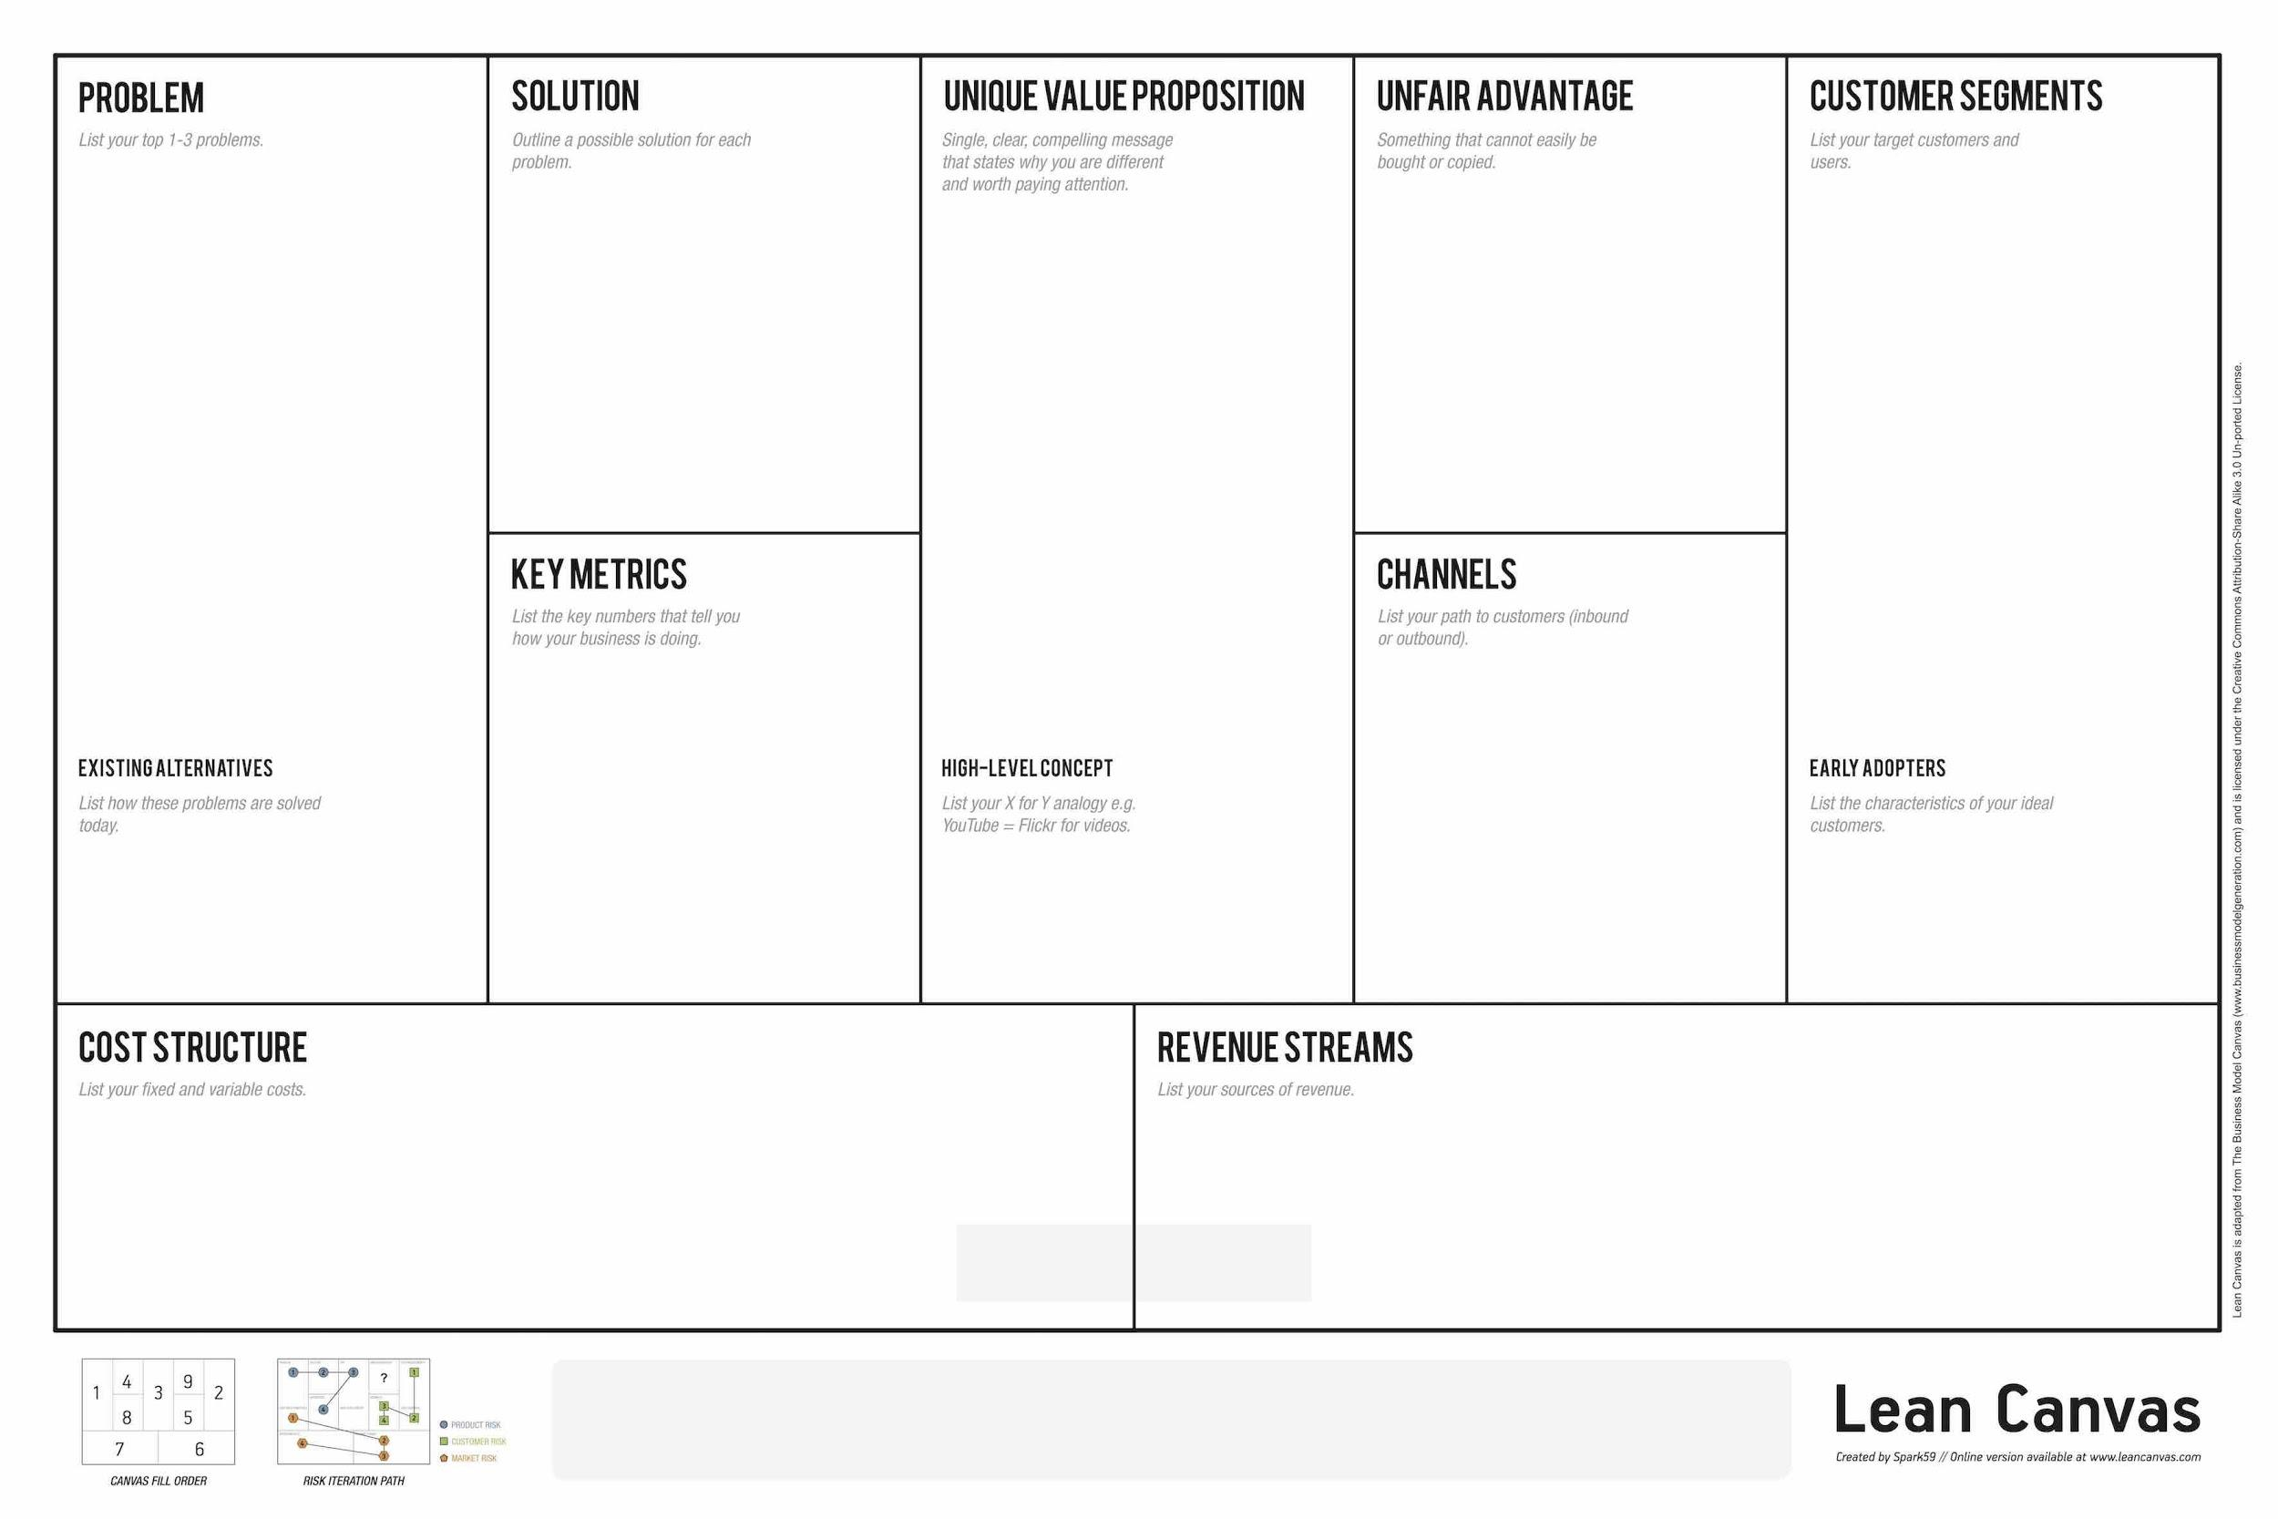
LEAN CANVAS MODEL

Slide 55
Important Points required for developing a B-Model or B-Plan
->Value Proposition
->Targeting Audience
-> Search Of Resources
->Channel of Marketing
->Customer Relationships
->Revenue Generation Streams
->Key Partnerships
->Key Activities
->Cost or Pricing

Slide 56
Value Proposition
Categorise your designed product is it solving the problem or need.

Slide 57
Targeting Audience
Whom Are you Targeting?
What is your customer segment?
Why should they purchase your product?
Or why should they hire your company for services?

Slide 58
RESOURCE ESTIMATION
FINANCE
Investors
Angel investors
Venture capitalist
1
PHYSICAL RESOURCES
MACHINES
MANUFACTURING UNITS
VEHICLES.
2
HUMAN RESOURCES
Intellectual people
Intellectual team members
Man Power
3

Slide 59

Channel Of Distribution
MARKETING CHANNELS
Physical
Virtual

Slide 60
Customer Relationships
It's High time now!!! To pitch your product to the targeting audience.

Slide 61
Revenue Generation
Streams
Points to ponder :
->Design the Revenue Model.
->Pricing of your Product is the Tactics.
->Analyse this how much customer want to pay for your designed product.

Slide 62
SOME REVENUE GENERATION MODELS
Subscription Model:
Software as a Service (SaaS) – e.g. Freshdesk
Service as a Service – e.g. PayU
Content as a Service
Infrastructure/Platform as a service – e.g. AWS, Azure
Membership Services – e.g. Amazon Prime
Advertising:
Display Ads - e.g. Yahoo!
Search Ads - e.g. Google
Text Ads - e.g. Google, Facebook
Video Ads - e.g. YouTube
Freemium Model
Adobe Flash,
Evernote,
Google Docs/Drive,
LinkedIn,
Prezi
E-commerce:
Retailing – e.g. Myntra
Marketplace – e.g. Snapdeal
Sharing Economy - AirBnB
Aggregators – e.g Taxi for Sure
Group buying – e.g. Groupon

Slide 63
Key Partnership
Collaboration is required for the purpose of gaining the experience of market.
The purpose of company tie ups are due to following reasons:-
Sharing the manpower and financial resources.
Sharing will also been done in terms of profits or data.
In simple terms we call it as “joint ventures”.

Slide 64
COSTS
Cost structure of implementing your Business Model.

Slide 65
Key Activities
Production
Problem solving
Supply Chain Management

Slide 66
MINI IDEATHON

Slide 67



TEAM
SWASTIKA
LEAD COORDINATOR
SANJANA DESWAL
HEAD COORDINATOR
UJJWAL AGGARWAL
LEAD COORDINATOR

